Slide 1


Recommender Systems

Slide 2

Malaysia AI
Malaysia AI Projects, a repository to gather projects related to Malaysia from multiple domain such as Tabular, Image, Text and Audio.
Run by Husein Zolkepli & Khursani
Malaysia Artificial Intelligence · GitHub
https://malaysia-ai-projects.readthedocs.io/en/latest/

Slide 3





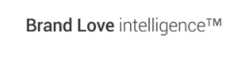

Surendran
Senior Data Scientist (SLB)
Some of Surendran’s relevant experiences include:
Lead and delivered multiple analytics projects that provide benefits to the organization's digitalization for an oil & gas company.
Delivered a novel machine learning model for a large Malaysia Telecommunication Company.
Delivered a reinforcement model to personalized learning environment that able to predict the receptivity condition of audience cluster for a start-up company.
Delivered an image classification model that use satellite Image to predict the economic well-being in India for World Resources Institute.
Using various statistical methods to analyse the role of connectivity on economic & human development with United Nation Development Plan .
Developed ML model for people with visual impairment to easily use buses through computer vision
Example clients:
An experienced Analytics Specialist with a demonstrated history of working in the industry and with variety domain exposure such as Biology, Telecommunication, Education and Oil & Gas. Strong analytics practical skill with developed analytic models in predictions for few projects.
Skilled in Data Science Tools, Management, Python programming, and Algorithms. Equipped with strong knowledge in Machine Learning Algorithms. Strong Information Technology professional with a Master’s Degree focused on Machine Learning from Multimedia University.
Lindedin : https://www.linkedin.com/in/surendr/
GitHub : Sureniology (Surendran Selvaraju) · GitHub
EDUCATION
Date | Discipline / University
2019 | Master of Science in Information Technology – Machine Learning, Multimedia University
2014 | Bachelor’s Degree of Science (Hons) , Bioinformatics, Multimedia University

Slide 4
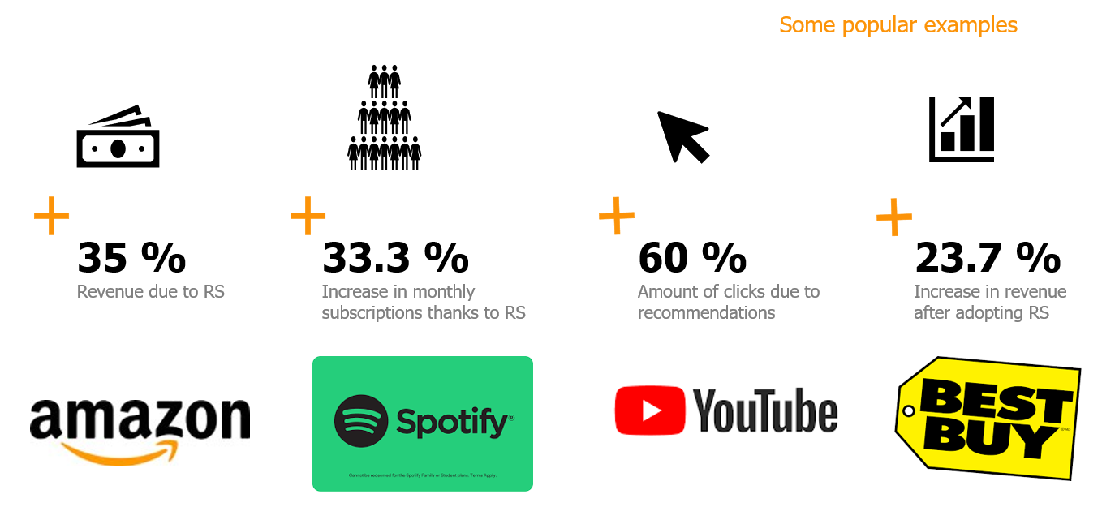
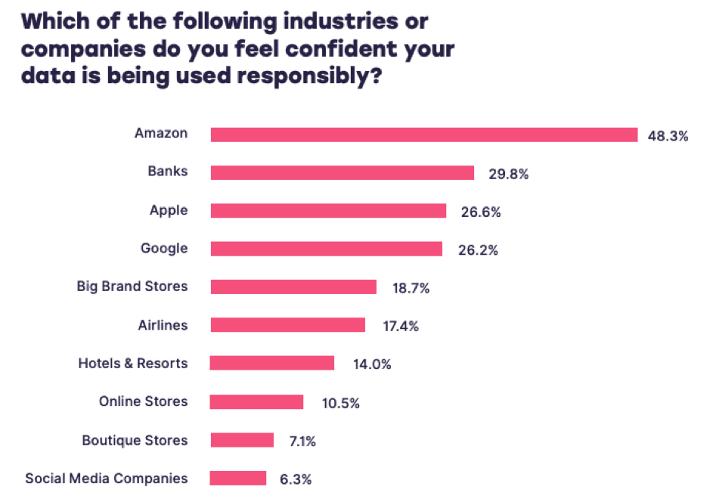
The Impact of Recommender System
35% of the purchases on Amazon are the result of their recommender system, according to McKinsey.
During the Chinese global shopping festival of November 11, 2016, Alibaba achieved growth of up to 20% of their conversion rate using personalized landing pages, according to Alizila.
Recommendations are responsible for 70% of the time people spend watching videos on YouTube.
75% of what people are watching on Netflix comes from recommendations, according to McKinsey

Slide 5
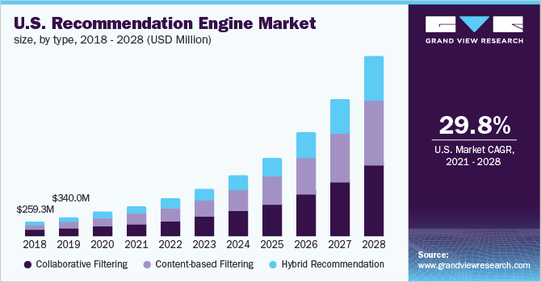
Recommender System Overview

Slide 6
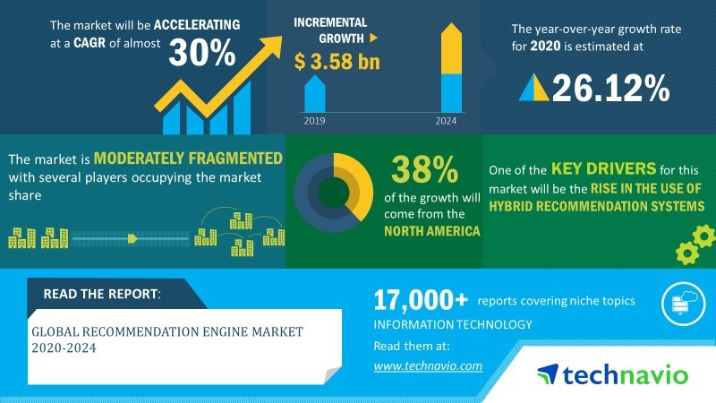
Recommender System Overview

Slide 7
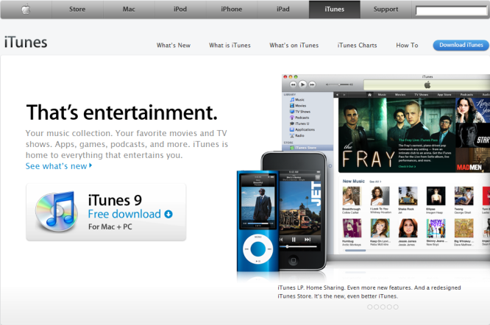
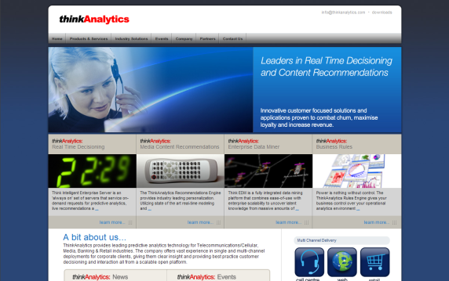
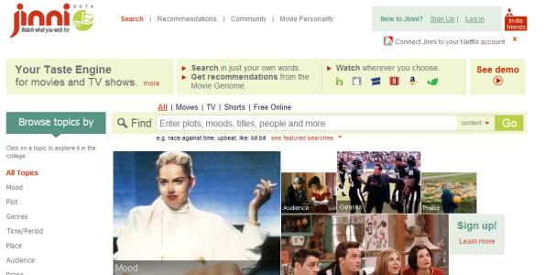
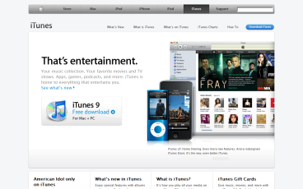
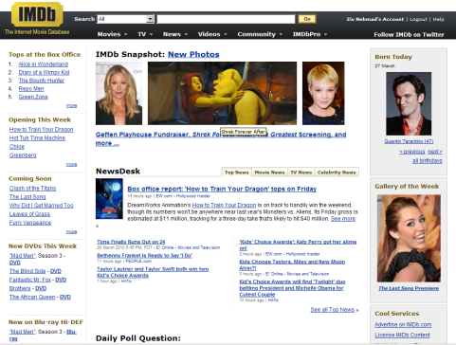


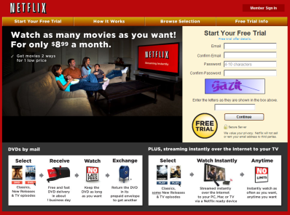
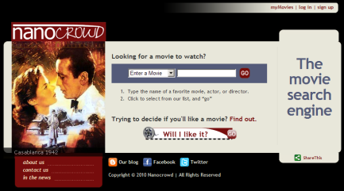
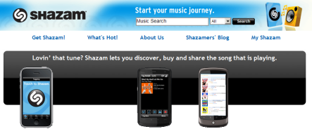
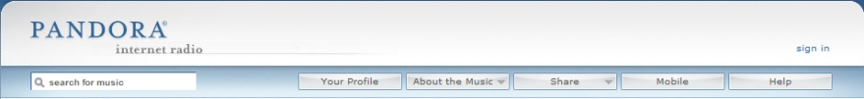

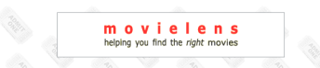


Recommendation Models
Model | Commonness | Used By:
 |  | Jinni | Taste Kid | Nanocrowd | Clerkdogs | Criticker | IMDb | Flixster | Movielens | Netflix | Shazam | Pandora | LastFM | YooChoose | Think Analytics | Itunes | Amazon
Collaborative Filtering |  | v |  |  |  | v | v | v | v | v | v |  | v | v | v | v | v
Content-Based Techniques |  | v | v | v | v |  | v |  | v |  |  | v | v | v | v |  | v
Knowledge-Based Techniques |  | v | v | v | v |  | v |  |  |  |  | v |  |  | v
Stereotype-Based Recommender Systems |  | v | v | v | v |  | v |  |  |  |  |  |  | v | v
Ontologies and Semantic Web Technologies for Recommender Systems |  | v |  | v |  |  |  |  |  |  |  | v
Community Based Recommender Systems |  | v |  | v |  | v |  |  | v | v |  |  |  | v | v
Demographic Based Recommender Systems |  |  |  |  |  |  |  |  |  | v
Context Aware Recommender Systems |  | v |  | v | v | v |  |  |  |  |  |  |  | v | v
Conversational/Critiquing Recommender Systems |  | v |  |  |  |  |  |  |  |  |  |  |  |  | v
Hybrid Techniques |  | v |  |  |  |  |  | v |  | v | v |  | v

Slide 8
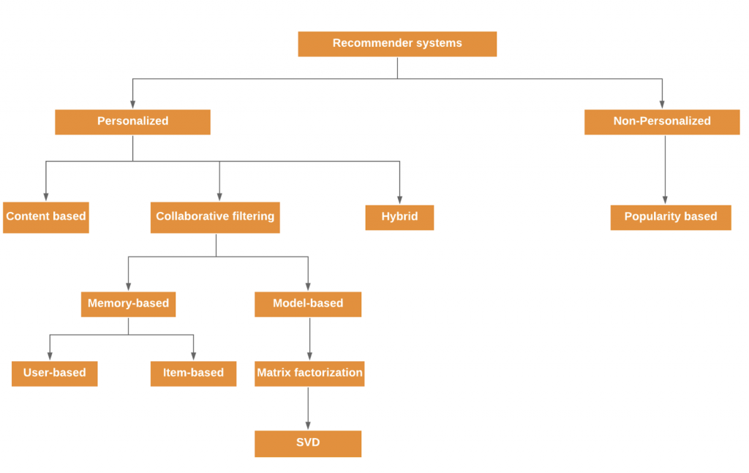
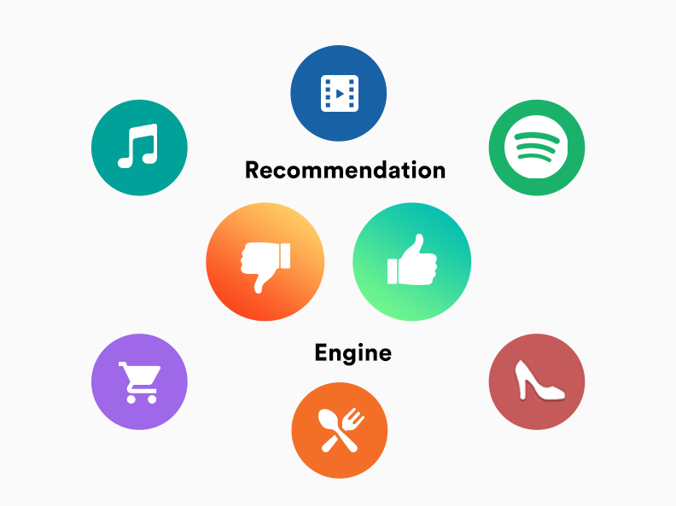

Slide 9
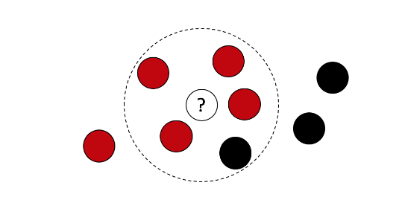
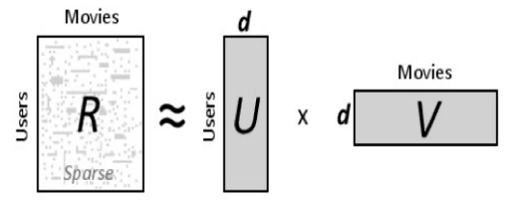
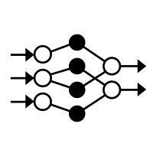
Collaborative Filtering Techniques
Nearest Neighbor
Matrix Factorization
Deep Learning
10.12.2022

Slide 10
Current User
Users
Nearest Neighbor Using predefined Similarity Measure
1
1st item rate
0
Dislike
?
1
Like
0
abcd
abcd
Prediction
1
Unknown Rating
abcd
1
The prediction was made based on the nearest neighbor.
Other Users
This user did not rate the item. We will try to predict a rating according to his neighbors.
There are other users who rated the same item. We are interested in the Nearest Neighbors.
1
Items
?
Unknown
0
1
1
User Model = interaction history
0
abcd
1
Nearest Neighbors
1
We are looking for the Nearest Neighbor. The one with the lowest Hamming distance.
abcd
1
Nearest Neighbor
1
0
14th item rate
Hamming distance
5
6
6
5
4
8
10.12.2022
10

Slide 11
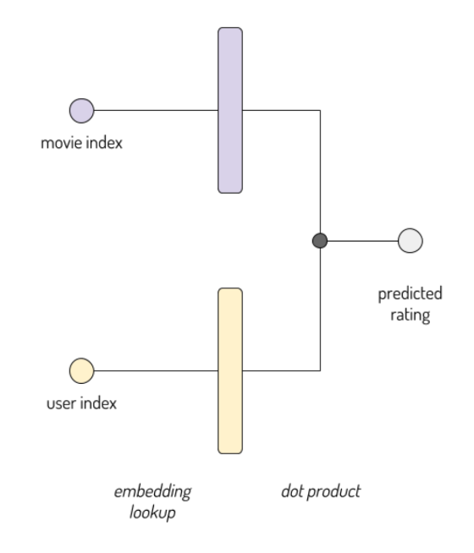
Matrix factorization for recommendation problems

Slide 12
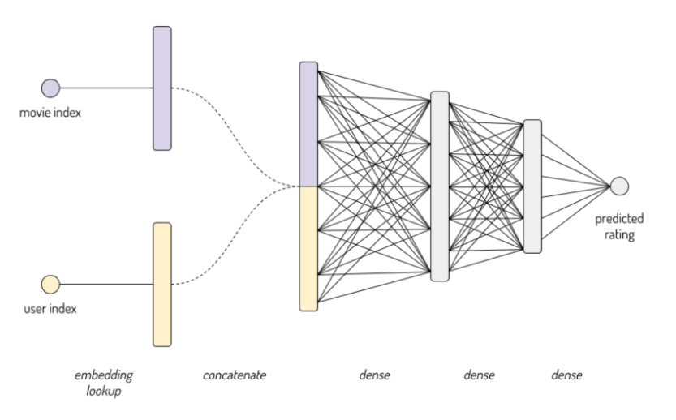
Neural Network Model to Predict the Ratings

Slide 13
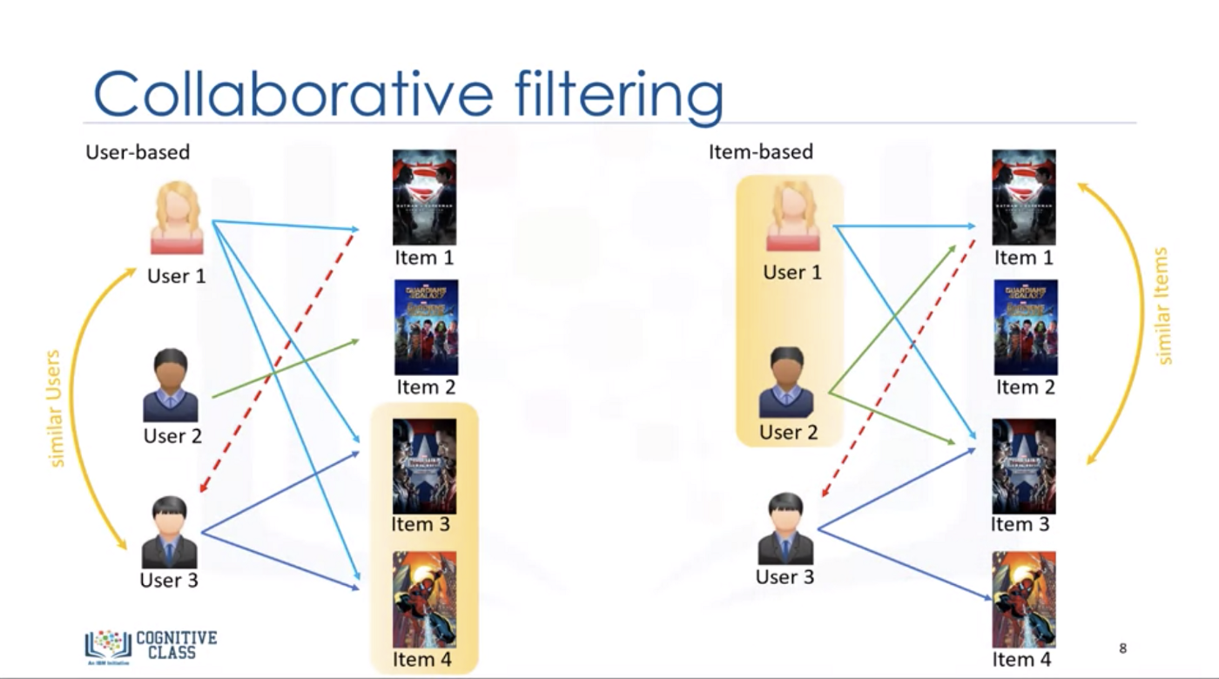
Collaborative Filtering
Maintain a database of many users’ ratings of a variety of items.
For a given user, find other similar users whose ratings strongly correlate with the current user.
Recommend items rated highly by these similar users, but not rated by the current user.
Almost all existing commercial recommenders use this approach (e.g. Amazon).

Slide 14
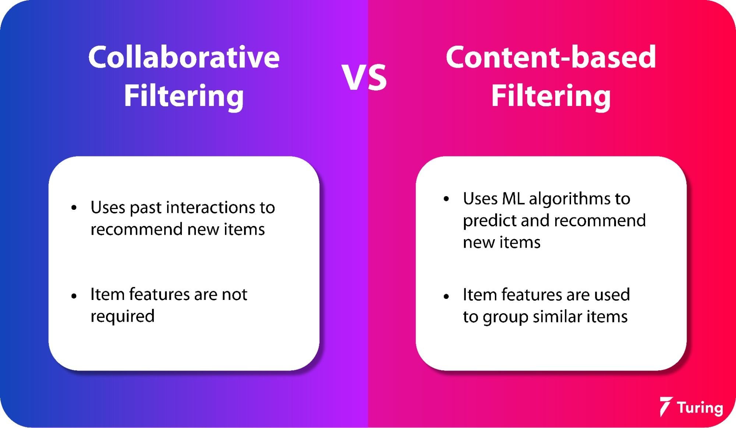
Collaborative Filtering vs Content-based Filtering

Slide 15
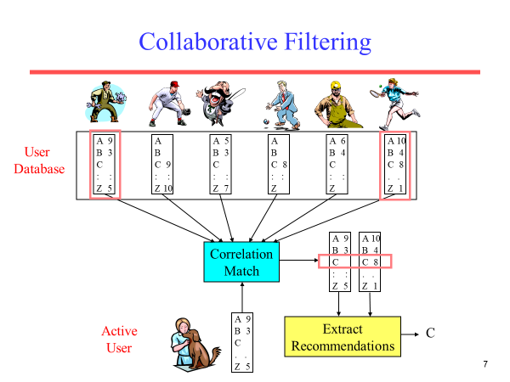

Slide 16
Collaborative Filtering Method
Weight all users with respect to similarity with the active user.
Select a subset of the users (neighbors) to use as predictors.
Normalize ratings and compute a prediction from a weighted combination of the selected neighbors’ ratings.
Present items with highest predicted ratings as recommendations.

Slide 17
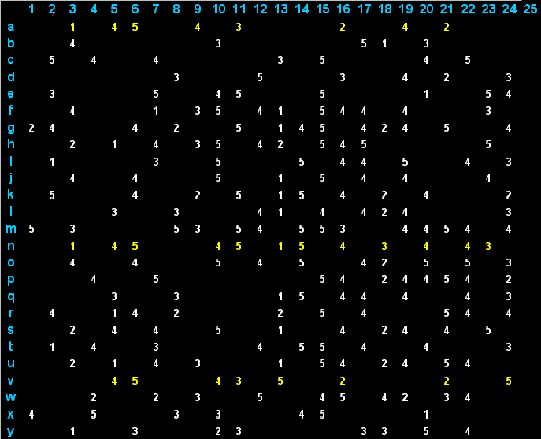
Collaborative Filtering Rating Matrix
Example of Rating Matrix :

Slide 18
Similarity Weighting
Typically use Pearson correlation coefficient between ratings for active user, a, and another user, u.
r_{a} and r_{u} are the ratings vectors for the m items rated by
both a and u
r_{i,j} is user i’s rating for item j

Slide 19
Covariance and Standard Deviation
Covariance:
Standard Deviation:

Slide 20
Problems with Collaborative Filtering
Cold Start: There needs to be enough other users already in the system to find a match.
Sparsity: If there are many items to be recommended, even if there are many users, the user/ratings matrix is sparse, and it is hard to find users that have rated the same items.
First Rater: Cannot recommend an item that has not been previously rated.
New items
Esoteric items
Popularity Bias: Cannot recommend items to someone with unique tastes.
Tends to recommend popular items.

Slide 21
References
https://towardsdatascience.com/recommendation-system-matrix-factorization-d61978660b4b
https://www.kaggle.com/code/colinmorris/matrix-factorization/notebook
https://www.sciencedirect.com/science/article/pii/S1110866515000341
https://www.analyticssteps.com/blogs/what-are-recommendation-systems-machine-learning
https://realpython.com/build-recommendation-engine-collaborative-filtering/
https://www.iteratorshq.com/blog/collaborative-filtering-in-recommender-systems/
https://developers.google.com/machine-learning/recommendation/collaborative/basics
https://www.turing.com/kb/collaborative-filtering-in-recommender-system

